Slide 1
British Airways Review Analysis

Slide 2
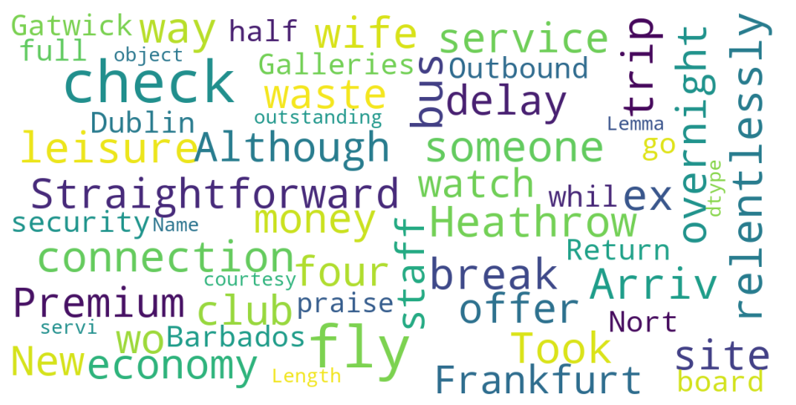
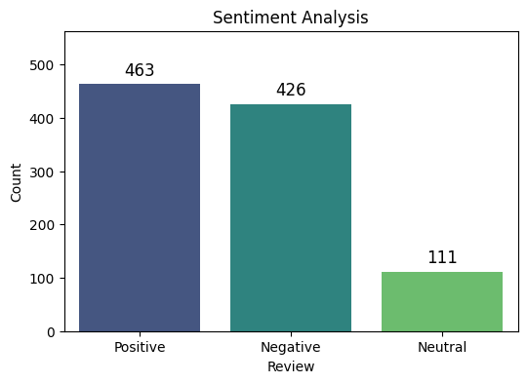
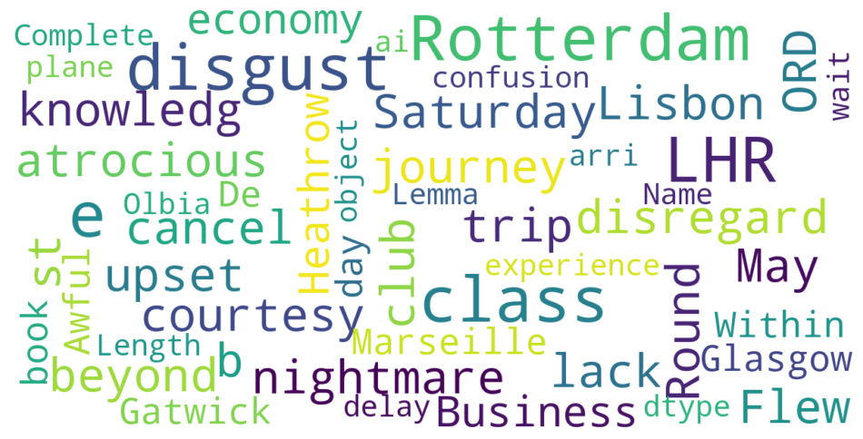
Overview
Analysis was done based on 1000 newest reviews that was scraped from airlinequality.com
Common Words in Positive Reviews
Common Words in Negative Reviews

